Slide 1
Examinations of male animals are made for two main purposes: either to ascertain whether normal fertility can be expected from the animal, or for the diagnosis of infertility.
The requirements are
1. history of the animal.
2. general health exam.
3.detailed examination of the genital tract.
4. observation of copulation.
5. collection and evaluation of semen.

Slide 2
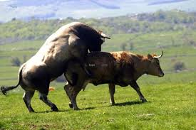
Reproductive efficiency of the male depends on:
1- Ability to service. (have a good libido, have the ability to mount and achieve intromission of the erect penis into the female vagina)
2- Ability to ejaculate enough amounts of good quality spermatozoa which can fertilize the ovum of the female.

Slide 3
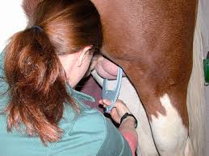
Physical Examination

Slide 4
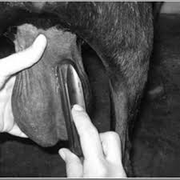
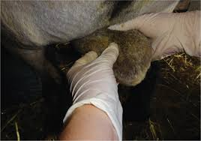

Slide 5
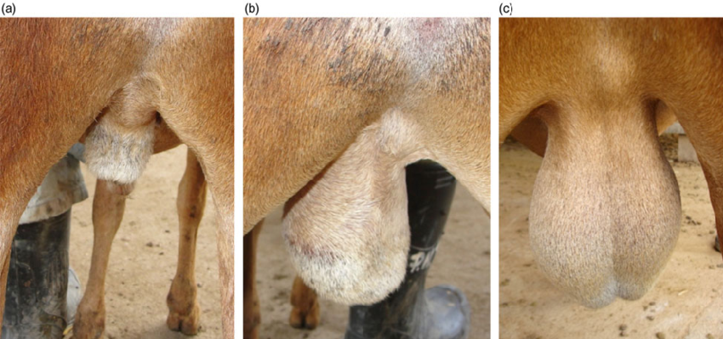
Examination the testes to affirmation the present two, one or absent of the testes such as cryptorchidisim.

Slide 6
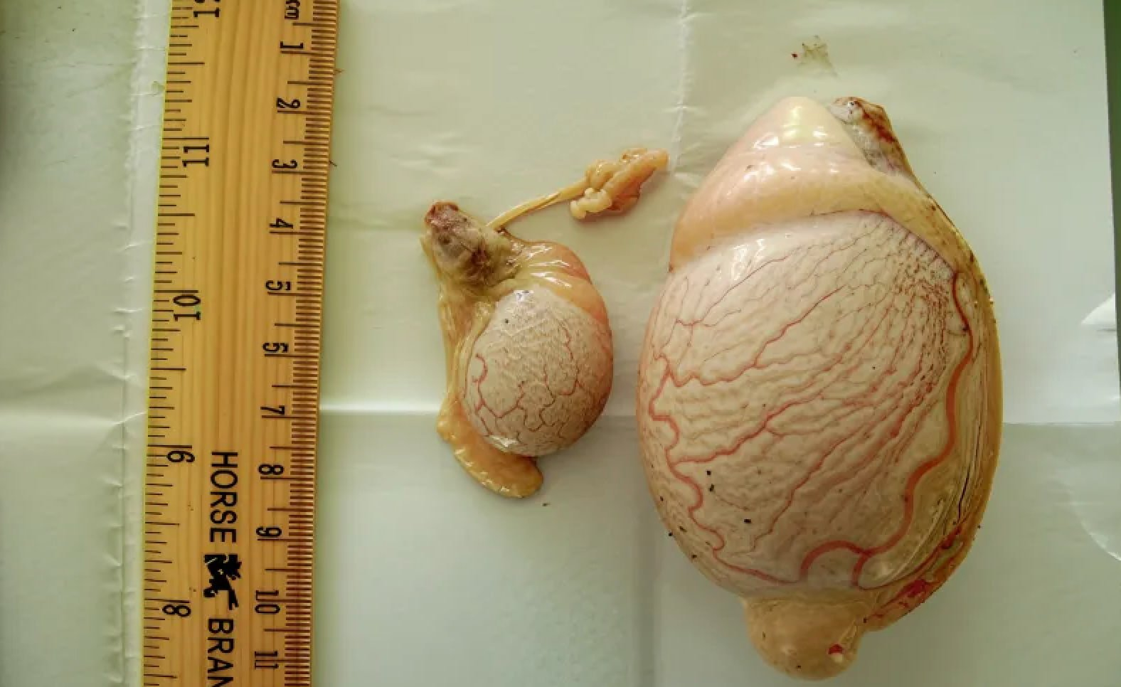
Testicular Hypoplasia in Male Animals | Testis Undergrowth

Slide 7
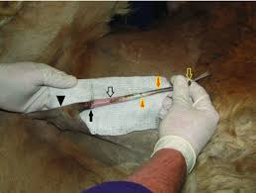
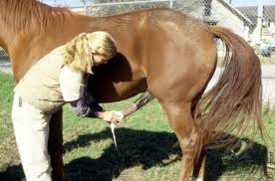
Examination the penis and doing the tests to detection any venereal diseases.

Slide 8
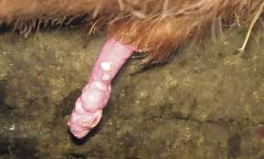

Slide 9
Examination before collection of the semen:
Know the age of puberty : Every species of the animals have a specific age in which the animal reach to the wholeness of the body structures and genital organs and become able to copulation and reproduction.
Puberty in the Male means: 1-Age when behavioural traits are expressed
2-Age at first ejaculation
3-Age when sperm first appear in the ejaculate
4-Age when sperm first appear in the urine
5-Age when the ejaculate contains a threshold number of sperm

Slide 10
Know the age of puberty
: Every species of the animals have a specific age in which the animal reach to the wholeness of the body structures and genital organs and become able to copulation and reproduction. Puberty in the Male means: 1-Age when behavioural traits are expressed
2-Age at first ejaculation
3-Age when sperm first appear in the ejaculate
4-Age when sperm first appear in the urine
5-Age when the ejaculate contains a threshold number of sperm

Slide 11
Average Age of Puberty
Type of animal | Age of male | Age of female
Bovine | 11 m | 11 m
Ovine | 7 m | 7 m
Porcine | 14 m | 6 m
Equine | 14 m | 18 m
Canine | 9 m | 12 m
Feline | 9 m | 8 m

Slide 12
In the seasonal poly estrus animals: should be Know the season of reproduction such as:
Mares: February – October.
Ewes and she goats: June – December.
Bitches, cats and wild animals: at the time of overabundance of the diet and good weather especially during the March and April.

Slide 13
Examination after collection: Examination the semen to know: Volume of the ejaculation and number of sperms per ml: the volume of ejaculation differs among the type of animals.
Class | Ml/ejaculate | Sperm conc. | No females
Bull | 5-6 | 800-1200 | 300-500
Ram | 1 | 800-4000 | 40-100
Boar | 200 | 25-1000 | 15-25
stallion | 50-150 | 30-800 | 8-12

Slide 14
massive motility of the sperms.
Individual motility of the sperms.
Percentage of the dead sperms.
Percentage of the abnormal sperms.

Slide 15
Components of seminal fluid
1- Spermatozoa. 2- Seminal fluid or plasma in which spermatozoa can swim or move. Seminal fluid or plasma composed from: Fructose, citric acid, vitamins, amino acids and protein, hormones, enzymes and fatty acids.

Slide 16
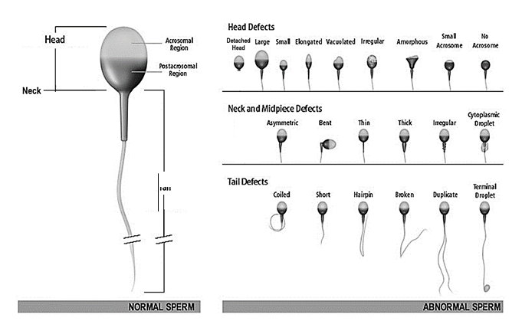
Sperm morphology The sperm composed from: Head, Nek, Middle and Tail.

Slide 17
Physiological characteristics of spermatozoa
1- Ability of nutrient metabolism by sperm body.
2- Able to move by the tail.
3- Process the ability to fertilize the ovum by the head of sperm.

Slide 18
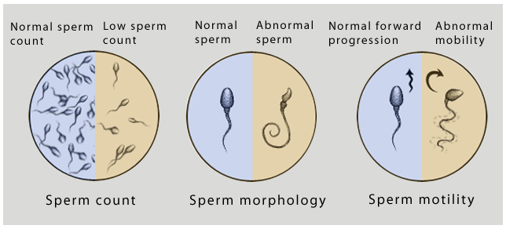

Slide 19
Rectal examination This is an important and essential part of the examination of the genital system of the bull. It enables the accessory sexual organs which are situated mainly on the pelvic floor to be examined and appraised .These structures are rarely involved in disease, but may individually or together become infected with serious consequences for semen quality and fertility. They should be methodically examined in the bull, commencing with the pelvic urethra to which the other structures may be readily related.

Slide 20
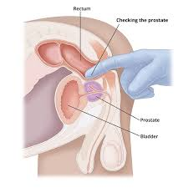

Slide 21
Further diagnostic tests Blood sample A blood sample may be taken to check whether the bull has been exposed to infection by such organisms as IBR/IPV/IBP virus. Antibody and antigen tests are taken for diagnosis of bovine virus diarrhoea (BVD) infection

